Slide 1
Conditional Random Fields
and their Application to
Labeling Objects and Places
University of Washington
Department of Computer Science & Engineering
Robotics and State Estimation Lab
Dieter Fox
Stephen Friedman, Lin Liao, Benson Limketkai

Slide 2
Relational Object Maps (RO-Maps)
Current maps (topological, occupancy, landmark) do not provide object-level descriptions of environments
Goal: describe environments in terms of objects (doors, walls, furniture, etc.) and places (hallways, rooms, open spaces).

Slide 3
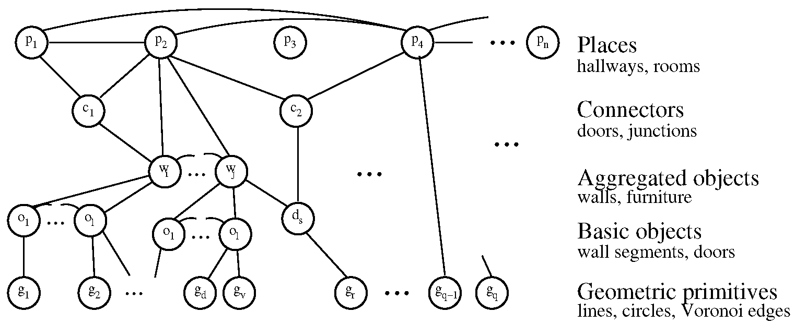
Relational Object Maps (RO-Maps)

Slide 4
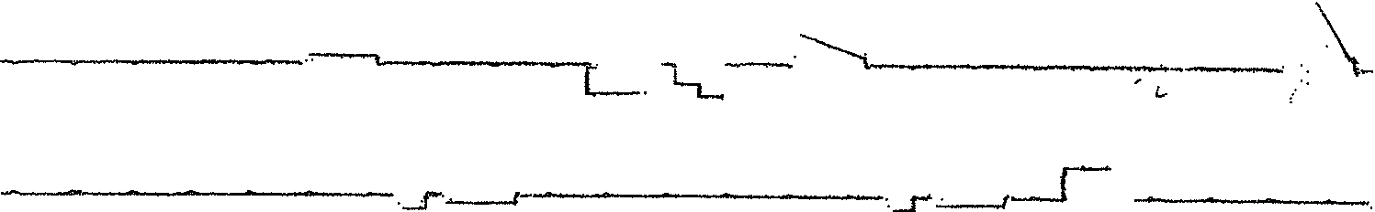
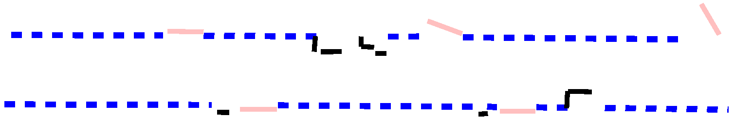
Context is Crucial
Needed:
  Probabilistic models to reason about complex spatial constraints
  Techniques to learn parameters of such models

Slide 5
Overview
Conditional Random Fields
Low-level detection of doors and walls
High-level place labeling
Future work

Slide 6
Conditional Random Fields (CRF)
Undirected graphical model
Introduced for labeling sequence data
No independence assumption on observations!
Extremely flexible
[Lafferty et al.; ICML 2001]
Hidden variables Y
Observations X
Notes:
Undirected Graphical models in which Nodes represent variables and edges indicate the dependencies between variables.
Variables could be observations, denoted as X; they can also be hidden variables, Y.
To infer the values of hidden variables, CRF combine a number of features using a log-linear model, that is, the exponent is the weight sum of the feature.
In the next slide I will explain the features .
The weight indicates and can be learned automatically using supervised learning.
CRF have been shown well-suited for

Slide 7
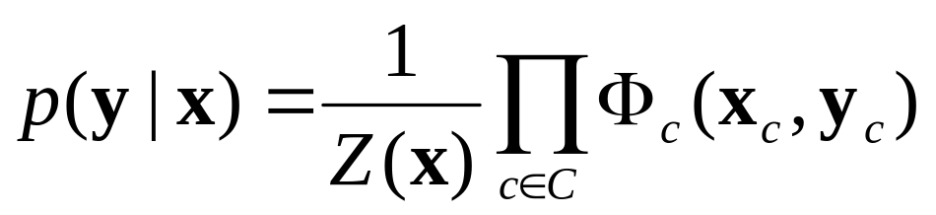
Probabilities in CRFs
Conditional probability defined via clique potentials (non-negative functions over variable values in cliques of graph)
Hidden variables Y
Observations X
Notes:
Undirected Graphical models in which Nodes represent variables and edges indicate the dependencies between variables.
Variables could be observations, denoted as X; they can also be hidden variables, Y.
To infer the values of hidden variables, CRF combine a number of features using a log-linear model, that is, the exponent is the weight sum of the feature.
In the next slide I will explain the features .
The weight indicates and can be learned automatically using supervised learning.
CRF have been shown well-suited for

Slide 8
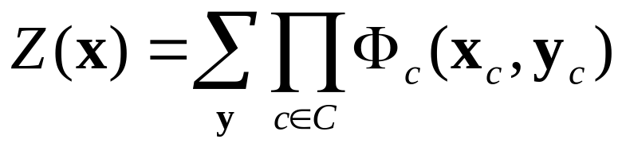
Probabilities in CRFs
Conditional probability defined via clique potentials (non-negative functions over variable values in cliques of graph)
Partition function Z(x) normalizes probabilities
(necessary since potentials are not normalized, as in directed models)
Notes:
Undirected Graphical models in which Nodes represent variables and edges indicate the dependencies between variables.
Variables could be observations, denoted as X; they can also be hidden variables, Y.
To infer the values of hidden variables, CRF combine a number of features using a log-linear model, that is, the exponent is the weight sum of the feature.
In the next slide I will explain the features .
The weight indicates and can be learned automatically using supervised learning.
CRF have been shown well-suited for

Slide 9
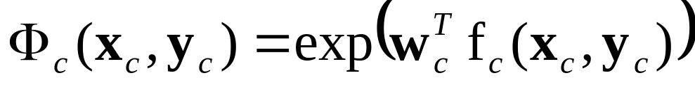
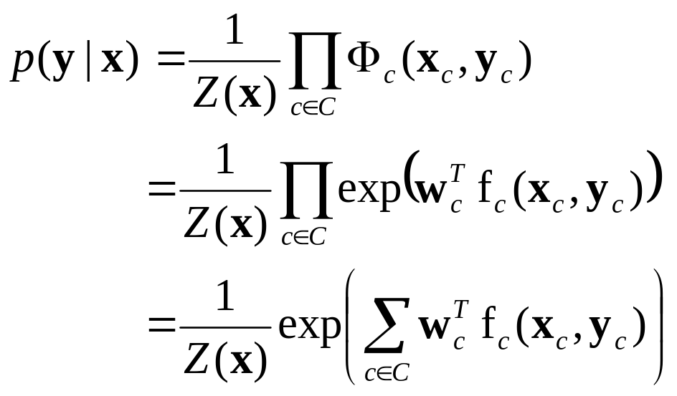
Log-linear Potential Representation
Typically, potentials defined via log-linear model
(linear combination of feature vectors extracted from variable values)
Thus
weight vec. feature vec.
Notes:
Undirected Graphical models in which Nodes represent variables and edges indicate the dependencies between variables.
Variables could be observations, denoted as X; they can also be hidden variables, Y.
To infer the values of hidden variables, CRF combine a number of features using a log-linear model, that is, the exponent is the weight sum of the feature.
In the next slide I will explain the features .
The weight indicates and can be learned automatically using supervised learning.
CRF have been shown well-suited for

Slide 10
Inference in CRFs
Compute conditional probability via local message passing called belief propagation (BP)
BP is exact if network has no loops (tree)
Corresponds to smoothing for linear chain CRFs
General networks: loopy BP (might not converge)
Can also compute MAP configuration
Alternative: sample configurations via MCMC
Notes:
Undirected Graphical models in which Nodes represent variables and edges indicate the dependencies between variables.
Variables could be observations, denoted as X; they can also be hidden variables, Y.
To infer the values of hidden variables, CRF combine a number of features using a log-linear model, that is, the exponent is the weight sum of the feature.
In the next slide I will explain the features .
The weight indicates and can be learned automatically using supervised learning.
CRF have been shown well-suited for

Slide 11
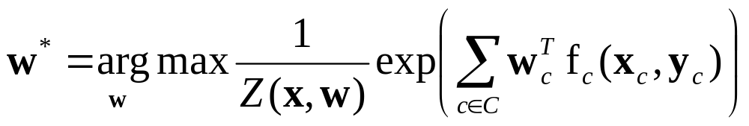
Discriminative Training of CRFs
Maximize conditional likelihood of labeled data
Conjugate gradient descent
  Compute gradient of log-likelihood wrt. weights
  Inference at each maximization step
  Optional: Maximize conditional pseudo likelihood
Typically zero mean shrinkage prior on weights
Notes:
Undirected Graphical models in which Nodes represent variables and edges indicate the dependencies between variables.
Variables could be observations, denoted as X; they can also be hidden variables, Y.
To infer the values of hidden variables, CRF combine a number of features using a log-linear model, that is, the exponent is the weight sum of the feature.
In the next slide I will explain the features .
The weight indicates and can be learned automatically using supervised learning.
CRF have been shown well-suited for

Slide 12
Overview
Conditional Random Fields
Low-level detection of doors and walls
High-level place labeling
Future work

Slide 13
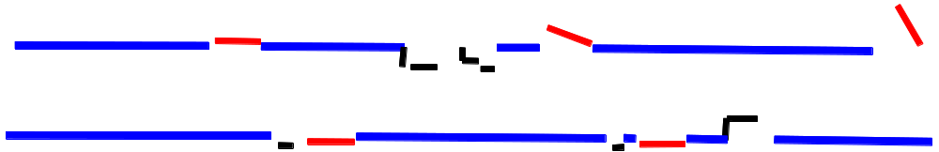
Relational Object Maps
Objects: Doors, Wall segments, Other
  Built from geometric primitives (line segments)
  Can generate more complex objects from existing ones via physical aggregation

Slide 14
Relational Object Maps
Objects: Doors, Wall segments, Other
  Built from geometric primitives (line segments)
  Can generate more complex objects from existing ones via physical aggregation
Relations
  Spatial
  Appearance-based

Slide 15
Inference: Labeling objects
Gibbs sampling
  Assign random label to each line segment
  At each MCMC step, update the label of some object by sampling from the conditional distribution.
When the label of an object k is changed, need to update the cliques and the parameters of objects involving object k.

Slide 16
Inference: Labeling objects
Goal: Estimate labels (types) of objects
Complication: Clique structures change based on label of object
physical aggregation

Slide 17
Experimental Setup
Maps of five different environments: one of Allen (UW) and four from Radish—Robotics Data Set Repository
Two to three hallways per environment; line segments labelled by hand
Five-fold cross-validation (i.e., train on hallways of four environments and test on hallways from fifth environment)

Slide 18
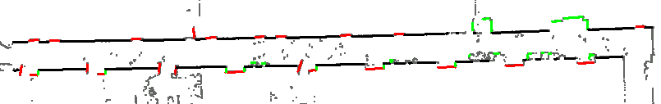
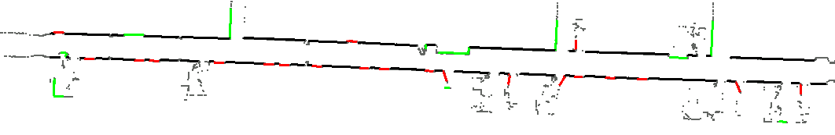
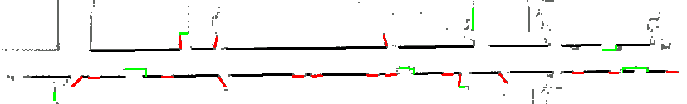
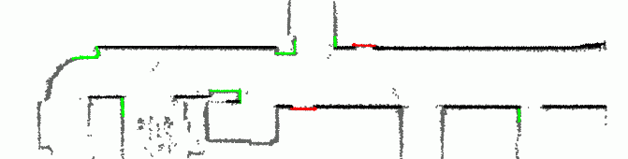
Sample Maps

Slide 19
Results: Confusion matrix
Truth | Inferred labels
 | Wall | Door | Other
Wall | 221 (94%) | 5 (2%) | 8 (4%)
Door | 1 (1%) | 122 (85%) | 21 (14%)
Other | 10 (9%) | 12 (10%) | 93 (81%)

Slide 20
Features
Local
  segment length
Neighborhood
  door-door, wall-door
Spatial
  door indentation, alignment with wall
Global
  variance of widths of doors in a hallway

Slide 21
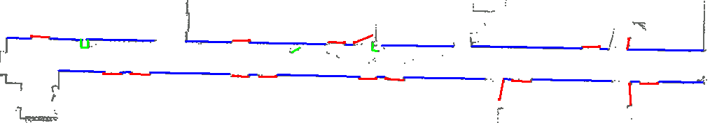
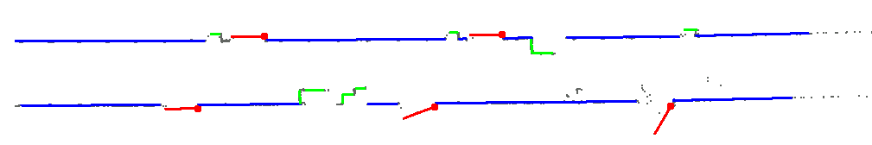
Typical Results

Slide 22
Results: Average accuracy rates
Environment | Features (% accuracy)
 | Local | Local + Neighborhood | All
1 | 62.6 | 88.5 | 90.7
2 | 58.7 | 63.0 | 93.5
3 | 59.0 | 79.2 | 89.7
4 | 51.8 | 96.5 | 97.7
5 | 60.0 | 68.5 | 77.9

Slide 23
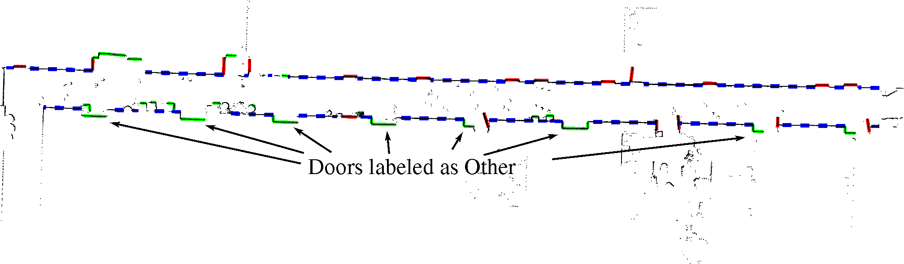
Worst Case

Slide 24
Shortcomings
Works for individual hallways only
MCMC is inefficient
  Learning: several hours
  Labeling: minutes
Idea: Detect objects conditioned on areas
(and vice versa)

Slide 25
Overview
Conditional Random Fields
Low-level detection of doors and walls
High-level place labeling
Future work

Slide 26
Place Labeling
Goal: Segment environment into places
Place types: Room, Hallway, Doorway, Junction, Other
Enables better planning and natural interface between humans and robots

Slide 27
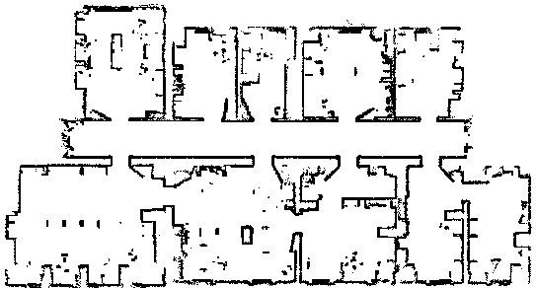
Goal
Room
Room
Corridor
Doorway
Corridor
Doorway
Courtesy of Wolfram Burgard
Notes:
But we can decomposed this map into different places with different functionalities
Like corridor, room and doorways
In this work I will show you how can we add this information to maps.

Slide 28
Local Approach Using AdaBoost
Learn to label individual locations
Extract laser range-features from occupancy map (size of area, difference between laser beams, FFTs, axes of ellipse, … )
Learn to classify locations using supervised AdaBoost learning

Slide 29
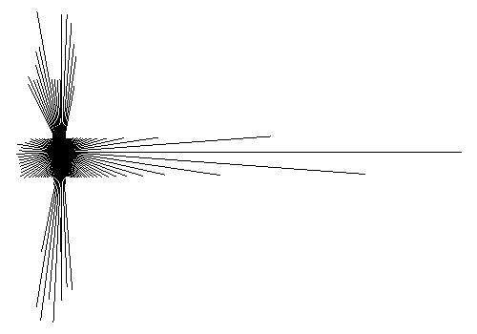
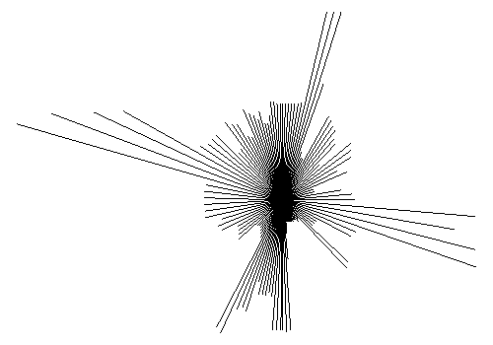
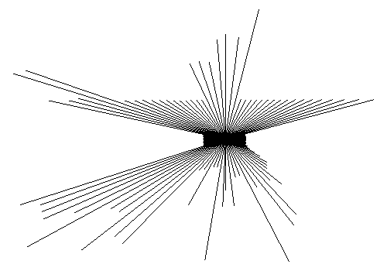
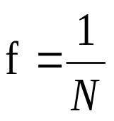
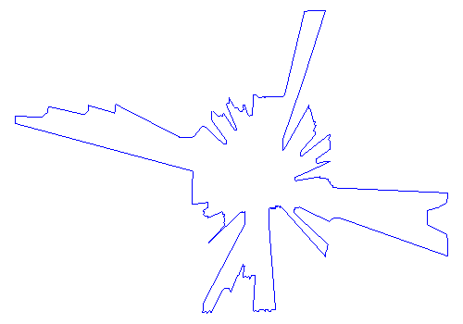


Simple Features
d
d_{i}
d
gap = d > θ
f = # gaps
minimum
Σ d_{i}
f = d
d
f =area
f =perimeter
f = d
Courtesy of Wolfram Burgard
Notes:
Here we have some examples of features extracted from observations
They all have in common that they are represented by one single value and the are rotational invariant

Slide 30
Combining Features
Observation:
There are many simple features f_{i}.
Problem:
Each single feature f_{i} gives poor classification rates.
Solution:
Combine multiple simple features to form a strong classifier using AdaBoost.
Courtesy of Wolfram Burgard
Notes:
So far we have lots of simple features.
But each feature is not able to do a good classification
Our solution is to combine all these features into a strong classifier using AdaBoost.

Slide 31
Key Idea of AdaBoost
B
O
O
S
T
I
N
G
observation_{N}
w₁h₁
.
.
.
.
Σ
θ
.
{1,0}
.
w_{T} h_{T}
observation₁
Strong binary classifier H using weak hypotheses h_{j}
Courtesy of Wolfram Burgard
Notes:
As input we have the different observations and the set of features we can extract from them.
The boosting algorithm selects the T features which best classify the observations and assign a weight to each of them.
The strong classifier takes de form of a majority vote classifier.
The parameter T is selected by the user.
The original AdaBoost was designed for binary classification.

Slide 32
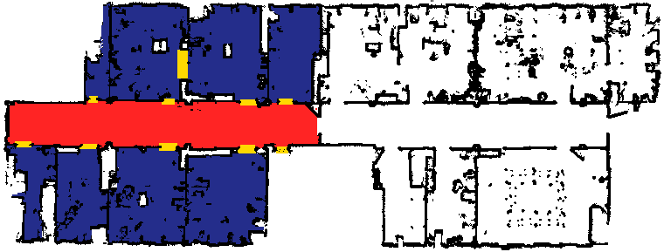
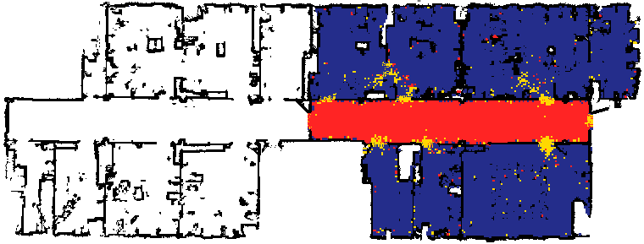
Example Experiment
Training (top)
# examples:
16045
Test (bottom)
# examples:
18726
classification:
93.94%
Building 079 Univ. of Freiburg
Corridor
Room
Doorway
Courtesy of Wolfram Burgard
Corridor
Room
Doorway
Notes:
The doorways are the more problematic because
they are small
there are no so many examples
Sometimes some places look like “doorways” because we are in 2D

Slide 33
Voronoi Random Fields
Local approach does not take neighborhood relation between locations into account
Neighboorhood defined via Voronoi Graph
Idea: Label points on Voronoi Graph using CRF

Slide 34
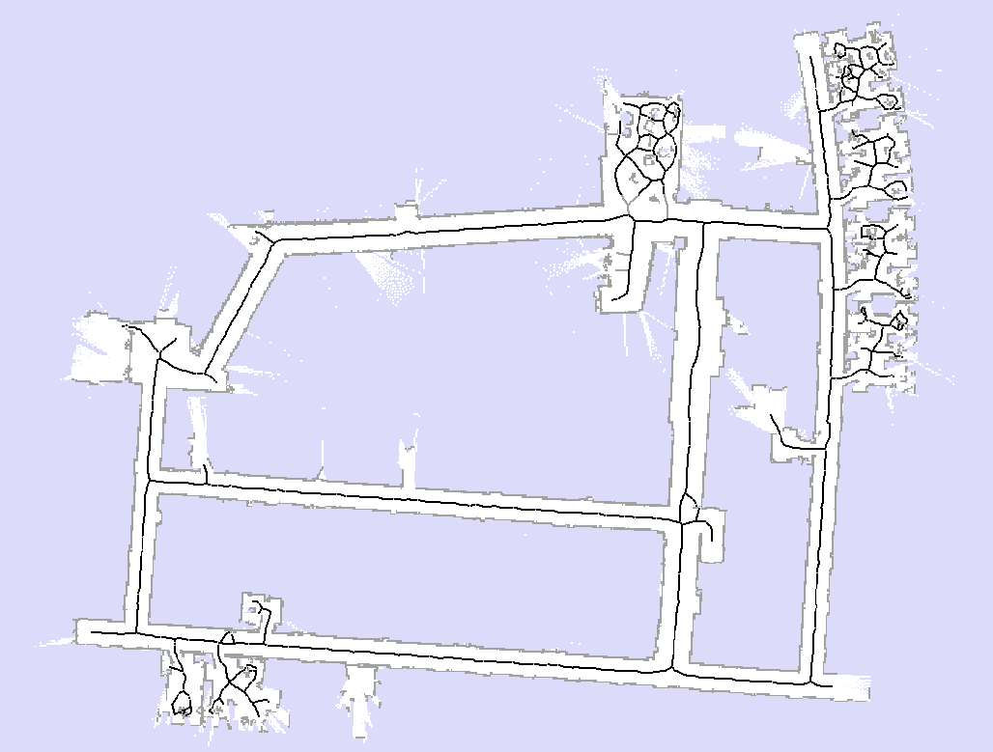
Voronoi Random Fields

Slide 35
Features
Spatial:
  Scan-based [Martinez-Mozos et al. 04]
  Voronoi graph-based
Connectivity via Voronoi graph:
  Type of neighbors
  Number of neighbors
  Size of loop

Slide 36
Learning
Learn decision stumps using AdaBoost
Feed decision stumps as binary features into CRF
Learn weights using pseudo-likelihood in CRF

Slide 37
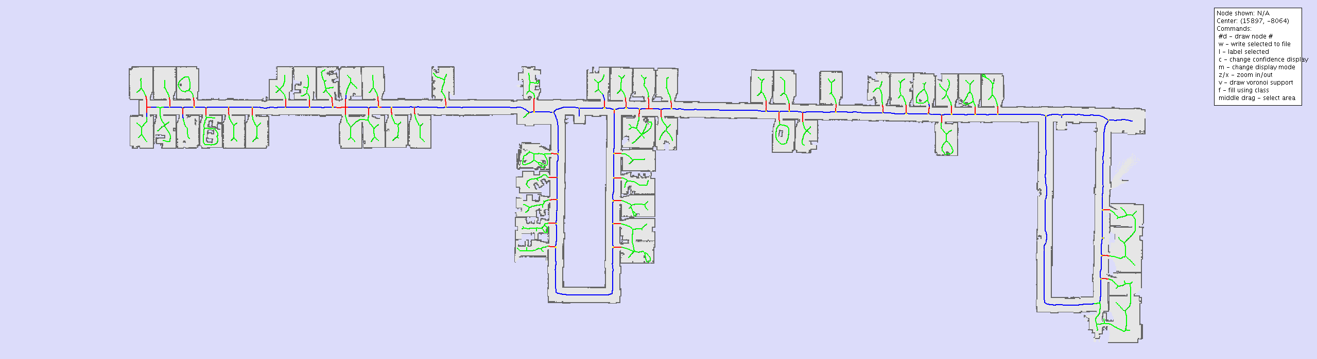
Maps

Slide 38
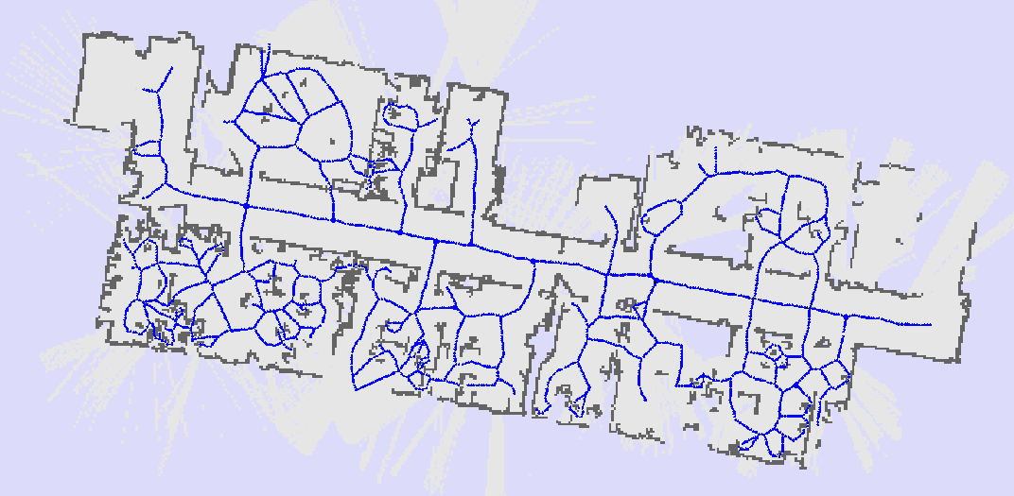
Maps

Slide 39
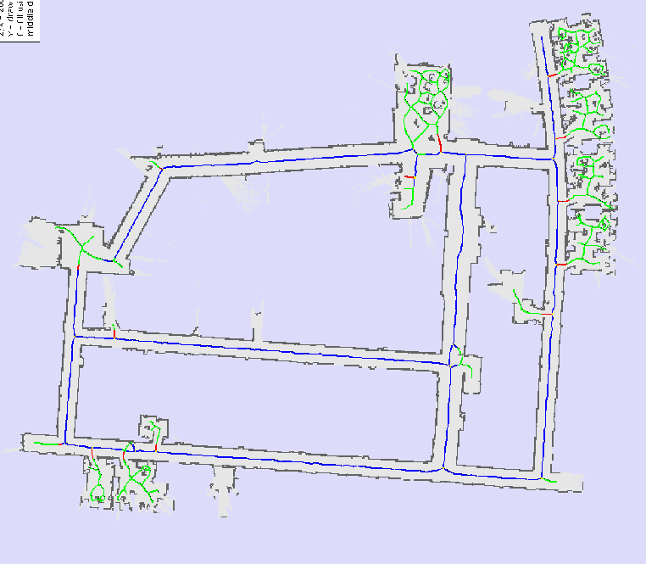
Maps

Slide 40
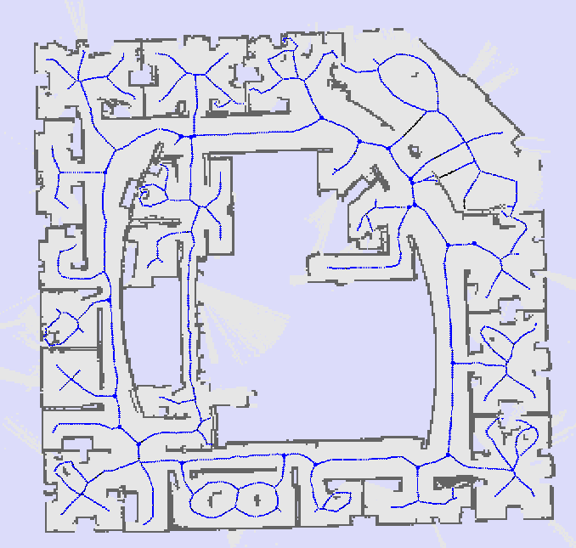
Maps

Slide 41
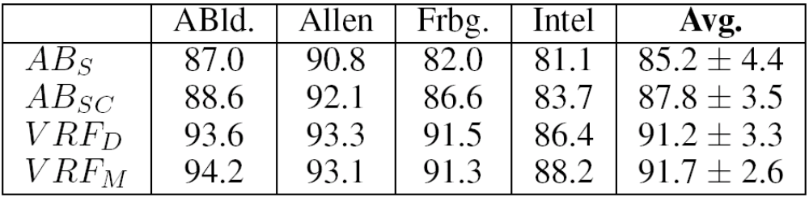
Experimental Results
Leave one out cross validation on 4 maps
Accuracy: Percentage correctly labeled

Slide 42
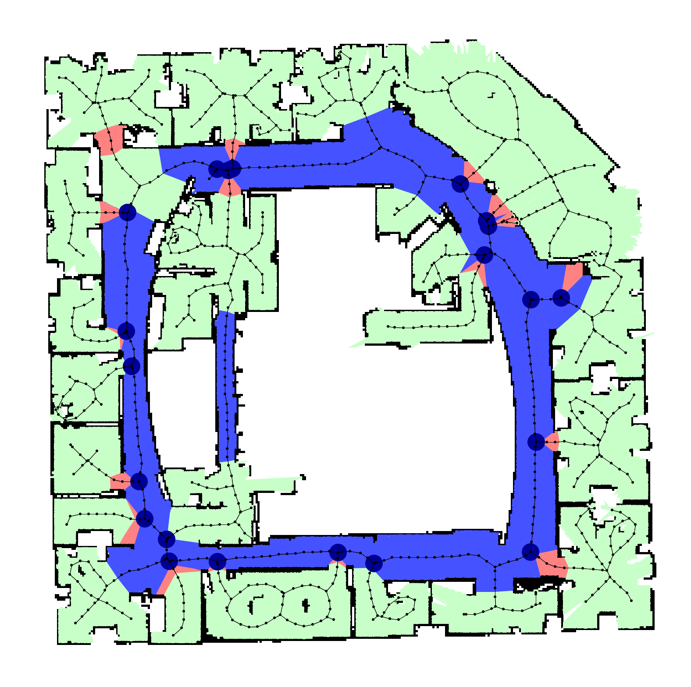
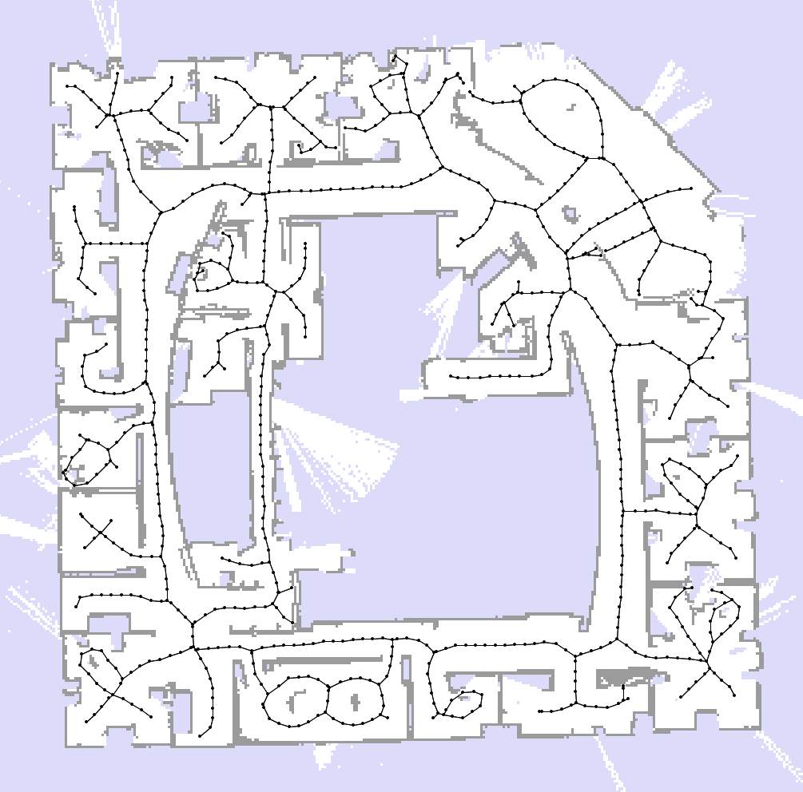
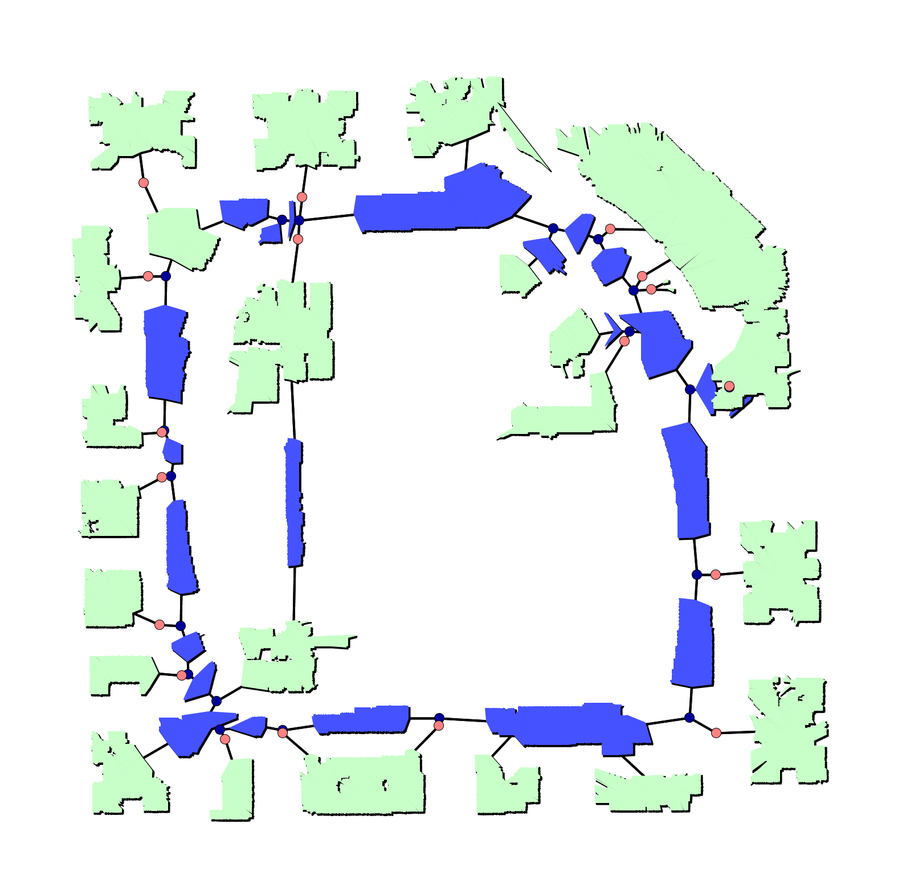
Place Labels Induced by VRF

Slide 43
Topological Map Induced by VRF

Slide 44
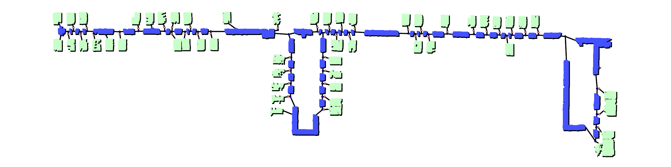
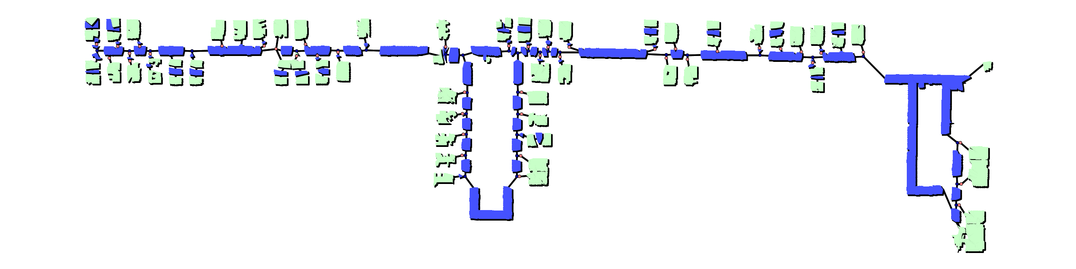
VRF
AdaBoost

Slide 45
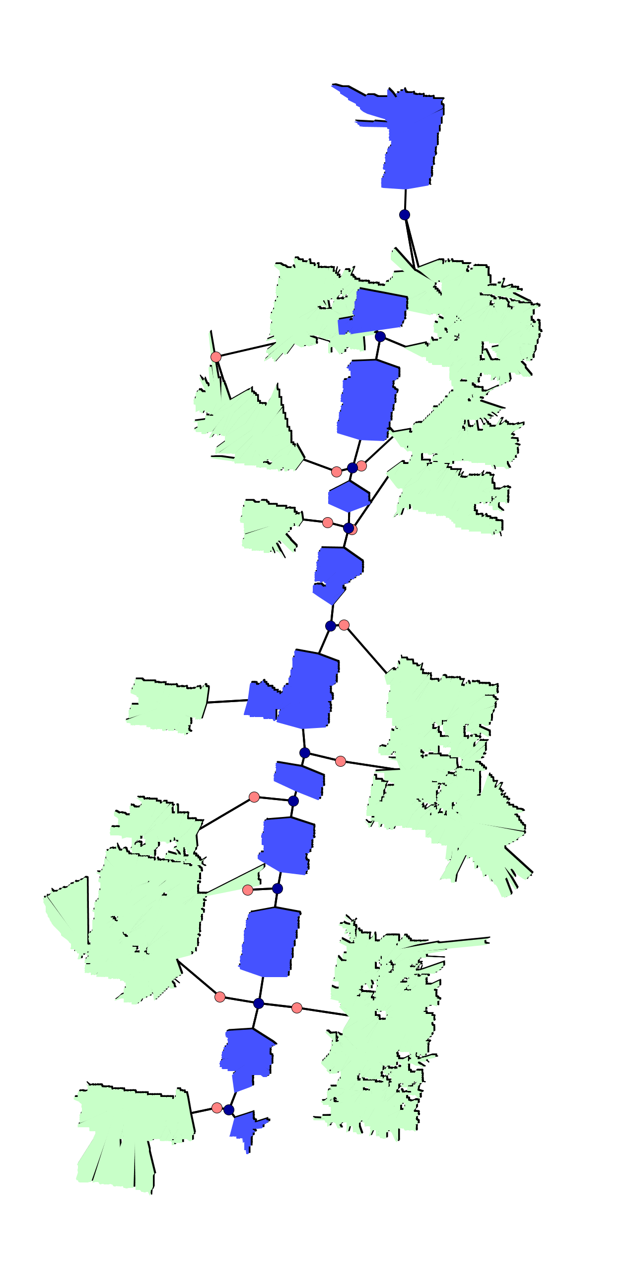
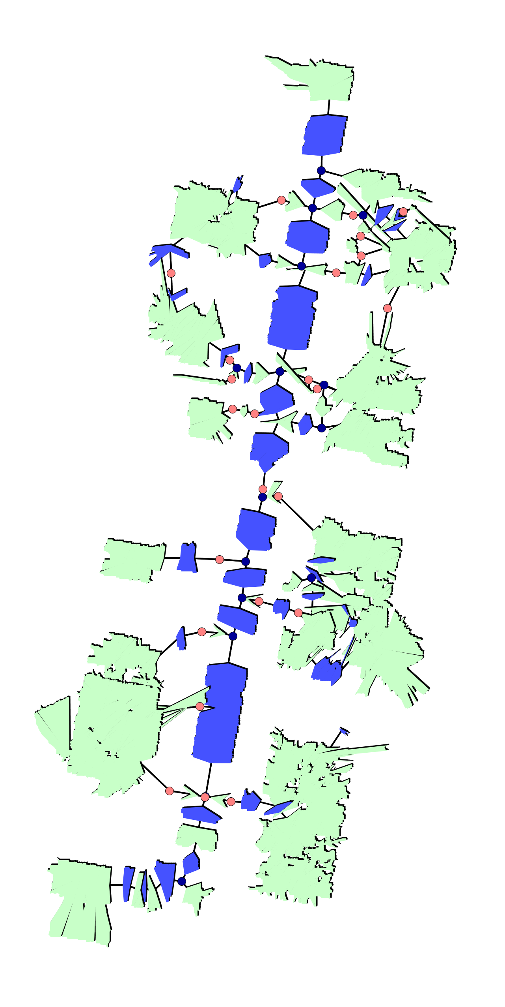
VRF
AdaBoost

Slide 46
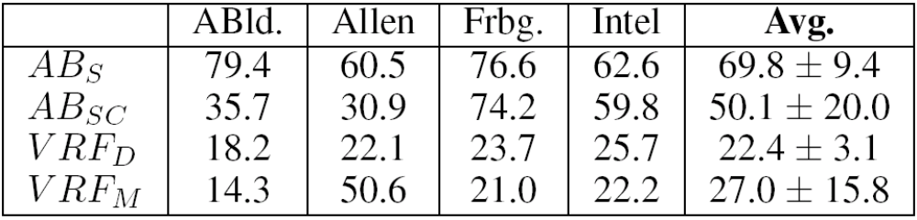
Experimental Results: Edit Distance
Consistency:
  Pick pair of points
  Compute shortest path
  Compare place sequence to ground truth using edit-distance

Slide 47
Conclusions
First steps toward object / place maps
CRFs provide powerful and flexible framework for learning and inference
Relational Markov networks provide language for reasoning about objects and CRF structures

Slide 48
Next Steps
Joint place labeling and object detection
Combine low-level and high-level CRFs
  k-best style inference to find places
  Label objects conditioned on places
  Re-evaluate place hypotheses
Use visual features
Joint feature and CRF learning

